Slide 1

MIDDLE EAST TECHNICAL UNIVERSITY Department of Statistics
STAT 292
TERM PROJECT I
Bennur Kaya
Beste Karaçay
Merve Erşahin

Slide 2
Description of the Problem
Coronary heart disease refers to a narrowing of the coronary arteries, the blood vessels that supply oxygen and blood to the heart. Research suggests that coronary heart disease (CHD) starts when certain factors damage the inner layers of the coronary arteries.
We have 10 variables, 3 of them are categorical.
Our dataset is consists of he countries where data are received, continents as in Africa, America, Asia, Europe, Ocenia, death rate per 100.000 people because of CHD, CHD Levels:
VH: Very High (If variable>=133.30)
H: High (If 133.30>variable>=89.76)
M: Medium (If 89.76>variable>=65.79)
L: Low (If variable<65.79),
life expectancy of people according to the countries, inactivity, sugar consumption per capita, obesity rate per country, number of cigarettes smoked per person and lastly total health expenditure per capita in U.S. dollars.

Slide 3

Question 1: Is there a relationship between expenses for health of the continents and rate of disease?
First, we wanted to check that if there is a relation between expenses for health of the continents and rate of disease. As it can be seen from the linear regression table, p-value (0.002975) is less than alpha value (0.05).

Slide 4
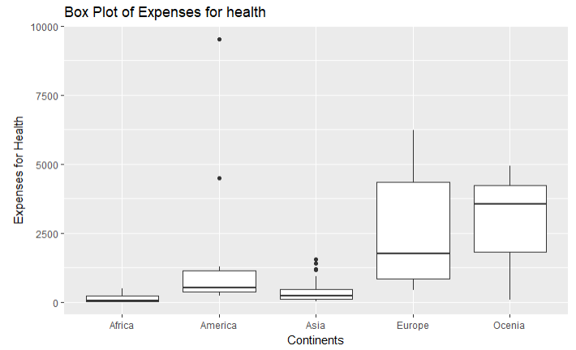
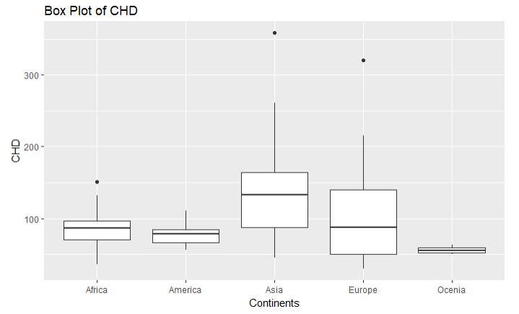

Slide 5
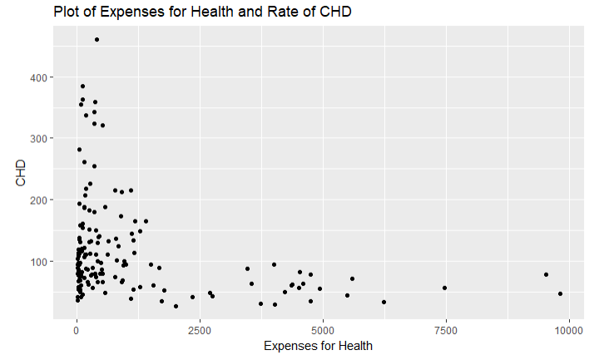
We can also see the relationship between CHD and expenses for health with scatter plot.

Slide 6
Question 2: The data set of Consumption of Sugar contains 94 observations with variance 11.6. We think that the mean rate of sugar consumption exceeds 25. Are we correct? Also, show that this claim is true or not with an appropriate graph, diagram or table.
Output of Zcalculated is -1.48 and z-alpha(0.05) is -1.645. Since z-calculated is greater than z-alpha value. That means, we have enough evidence to say that the mean rate of sugar consumption is greater than 25.
Also, a box plot is created in order to do conclusion visually.

Slide 7
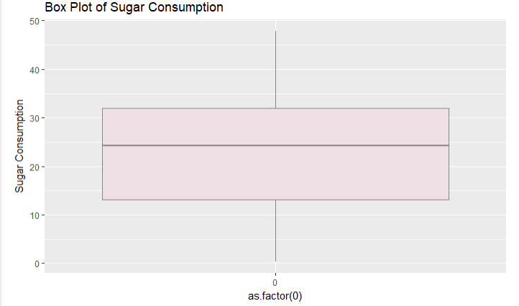

Slide 8
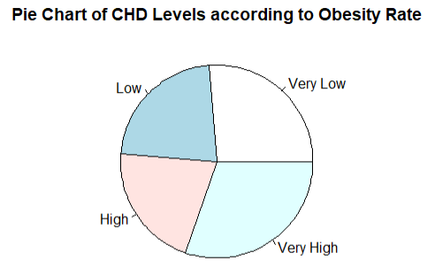
Question 3: After examining the pie chart of Obesity Rate according to CHD levels, compare the obesity rates of low and high CHD levels. Is the obesity rates of low CHD level greater than high CHD level? If this is not sufficiently obvious, use the appropriate test.
It is founded that the calculated z value which is 0.0307 is smaller than z alpha(0.05) value, 1.645.

Slide 9
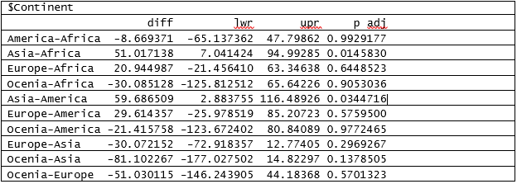
Question 4: Does number of people who died because of the disease changes according to continents?
ANOVA table is created to investigate this problem.

Slide 10
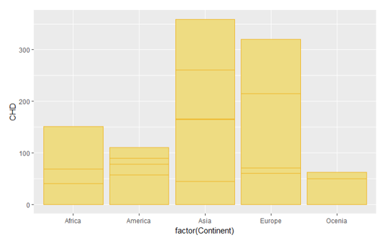
Moreover, as we can see from the bar plot below, the rate of death changes according to the continents. Asia has the highest rate and Europe follows Asia.

Slide 11
Multiple Linear Model
CHD = 176.9-1.67*LifeExpectancy-0.9*Inactivity+ 1.29ConsOfSugar+2.37*ObesityRate+0.03*TobaccoCons-0.015*HealthExpenditure
There is more than one predictor variable which affects the number of death because of Coronary Heart Disease and these are life expectancy, inactivity, consumption of sugar, obesity rate, tobacco consumption and health expenditure.
For example;
When Sugar Consumption is increased one unit, the rate of death because of Coronary Heart Disease also increases 1.29 unit.

Slide 12
Thank you for your attention, if you have any question we would like to answer them.

